Slide 1
R Basic

Slide 2
Basic Numerical Operation
log2(x); log10(x); log(x); log(x, base); exp(x); e = exp(1); pi
floor(x); ceiling(x)
NA, is.na, Inf(Inf-Inf; o/o; NaN)
round(x)
table(x) – frequency table
x %% y – mod; %/% -- integer division
choose(n, x)
rank(x)
unique(x)
sort(x)

Slide 3
Function Apply
apply(obj1,margin,fcn) -- applies the function to margin of the object;
tapply(vec1,fac1,fcn1) -- applies the function to a vector by levels of the specified factor;
lapply(vec1,fcn) -- applies the function to each element of a vector, returning a list;
sapply(vec1,fcn) -- similar to lapply, but combines results together;

Slide 4
Number Creation
seq(start, end, step) – [s, e]
rep(x, each = m, times = n)
sequence(c(4:3)) == c(1:4, 1:3)
x = (1:4)^(2:3)
x = factor(a,levels=c("D","C","B","A"));
cat("Empirical probability of type-I error:", p.hat, "\n")
cat("True value of type-I error:", alpha, "\n")

Slide 5
Random Number Generate
x = rnorm(10); x = runif(n); runif (n, a, b); matrix(runif(n*m), nrow=n, ncol=m); matrix(runif(n*m), n, m)
x = sample(x, size, replace = FALSE, prob = NULL) – sampling
x = sample(x, size, replace = FALSE, prob = c(.2, .3, .5)) – sampling

Slide 6
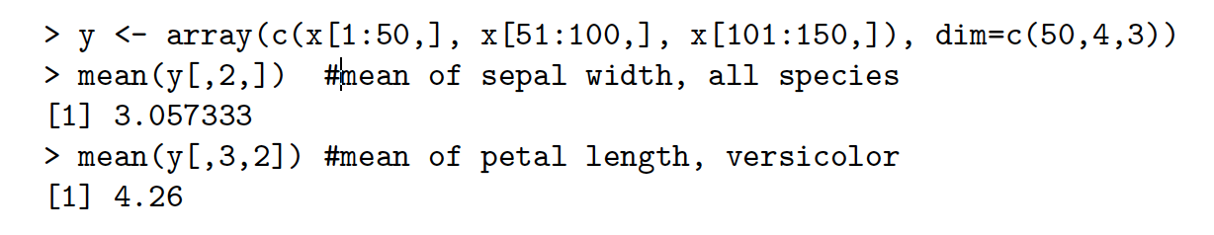
Vector & Matrix
rbind(x1,x2), cbind (x1,x2);
matrix(data = NA, nrow = 1, ncol = 1, byrow = FALSE, dimnames = list(c("I","II","III"),letters[1:3]));
length(x) – Length of x(1D);
rowMeans(), rowSums(), colMeans(), colSums();
names(iris) – DF column name;
attach(iris); detach(iris)
nrow(hflights); ncol(hflights);
sigma <- matrix(c(1,-0.5,0.5,-0.5,1,-0.5,0.5,-0.5,1), 3, 3)

Slide 7
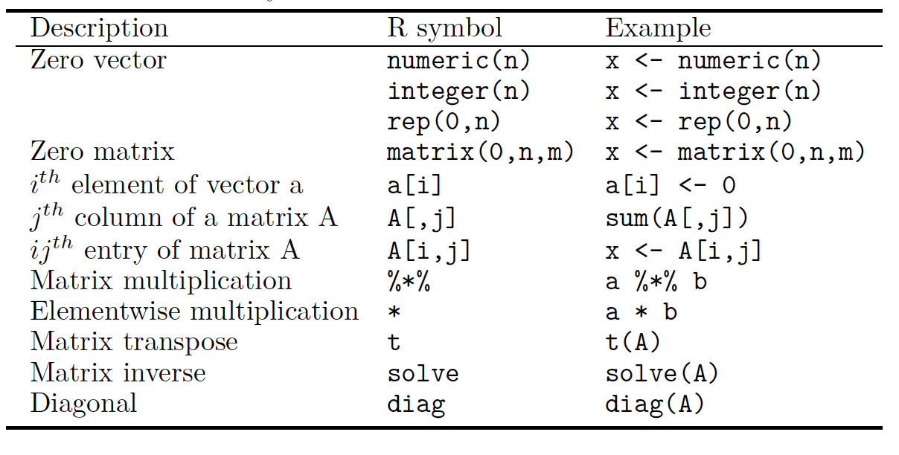

Slide 8
Data Indexing
x[2:4]; x[c(1,3,5)];
ind1=(x>2); ind1; x[ind1] ;y=x[x>2];
y = x[!is.na(x)];
x <- 2:10; name;
painters[Colour>15 & School!="D",]; s(x)=letters[1:9]; x["b"];
u=data.frame(x,y); ev=(1:5)*2; u[x %in% ev, ]; match(x,ev,nomatch=0);
sflights <- hflights[, c("DepTime", "ArrTime", "FlightNum")];
BNum <- hflights$FlightNum > 1000;
sflights <- data.frame(sflights, BNum);
y <- data[data$Entity == 'Global', 'Median']

Slide 9
Data Indexing
Compute the average arrival delay (ArrDelay) to each destination for `hflights`. (Hint: use na.rm = TRUE to remove missing values)
by(hflights$ArrDelay, hflights$Dest, mean, na.rm = TRUE);
For each carrier, calculate the percentage of flights cancelled or diverted.
by(hflights$Cancelled+hflights$Diverted, hflights$UniqueCarrier, mean, na.rm = TRUE);
x[u>=0.5] <- (-log(2-2*u[u>0.5]))
x[u<0.5] <- log(2*u[u<0.5])

Slide 10
Descriptive Statistics
quantile
prod
cumsum; cumprod; cummax
var, sd, cor, cov, summary

Slide 11
Others
getwd() -- get the working directory;
setwd(path1) -- set the working directory to “path1”;
find("lm") -- gives the package a function (e.g. lm) that comes with;
search() -- lists all libraries and data frames in the search path;
sink("filename.format") -- divert all subsequent output to external file;
Linear model:
lm(cars$dist~cars$speed); attach(cars); y <-lm(dist~speed); summary(y)

Slide 12
Import Data
read.table(file, header = FALSE, sep = ‘’, na.strings = “NA”);
read.csv, read.csv2, read.delim, read.delim2;
readLines -- reads lines of a file as character strings;
Function Definition
fx <- function(x, a, b){
y <- (x-a)/b
return(y)
}

Slide 13
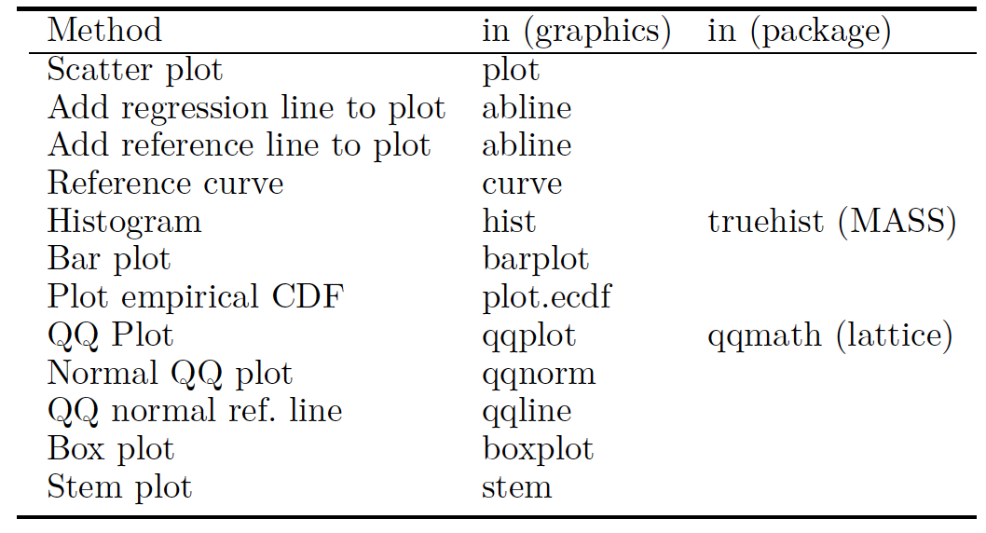
Graphics

Slide 14
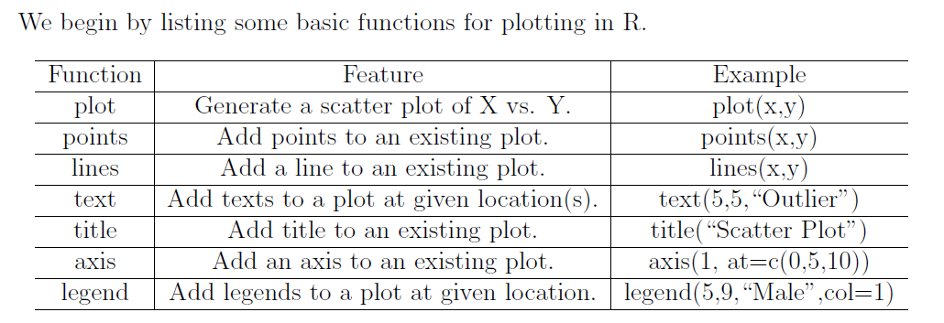

Slide 15
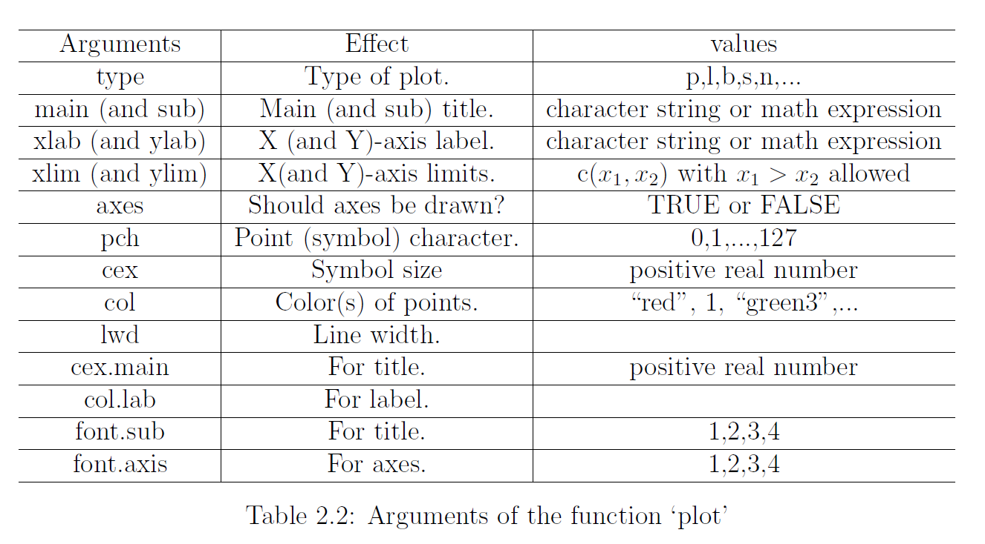

Slide 16
Scatter plot
attach(cars);
plot(x, y, main="graph name", pch=23, cex=1, col="black", bg="red");
plot(0:10,0:10,type="n",axes=F,xlab="",ylab=""); plot.new(); -- empty plot;
points(x,y) -- add points to an existing graph;
points(x, y, pch=22, bg="blue", cex=2);
lines(x,y); -- add a line to an existing graph; mtext(text, …) – add text;
lines(x, y);
text(speed[49], dist[49],"outlier");
mtext("nice one", side= 4, col="green");
title(expression(phantom("Title 1 ") * "and “ * phantom("Title 2"), col.main="black")); -- add a title;

Slide 17
Scatter Plot Matrix
data(iris); pairs(iris[101:150, 1:4]);
panel.d <- function(x, ...) {
usr <- par("usr"); on.exit(par(usr));
par(usr = c(usr[1:2], 0, .5))
lines(density(x)) # add density curve.
}
x <- scale(iris[101:150, 1:4])
r <- range(x)
pairs(x, diag.panel = panel.d, xlim = r, ylim = r)
splom(~iris[1:4], groups = iris$Species, col=1, pch=c(1,2,3), cex=c(.5,.5,.5))
# group data by ‘groups’; library(lattice)
Notes:
panel.d <- function(x, ...) {
usr <- par("usr"); on.exit(par(usr));
par(usr = c(usr[1:2], 0, .5))
lines(density(x)) # add density curve.
}
r <- range(x)
pairs(x, diag.panel = panel.d)

Slide 18
Curves & Shapes
library(emdbook);
f=function(x,y){
2*x^2+y^2-1
};
curve(dt(x,df=5),-3,3); curve(x^2-2,-2,4); curve(dnorm(x),-3,3) ;
curve3d(f, xlim=c(-3,3),ylim=c(-2,2),n=c(100,100), sys3d="contour",levels=0);

Slide 19
Correlation Plots
library(corrplot);
corrMat <- cor(data[, 1:10]);
corrplot(corrMat, type = "upper", method = "square", addCoef.col = "black", diag=FALSE, tl.col="black", tl.srt=45);
Pie Charts
slices <- c(10, 12,4, 16, 8);
lbls <- c("US", "UK", "Australia", "Germany", "France");
pie(slices,labels = lbls, col = rainbow(length(lbls)), main = “Name");
Histogram
hist(mtcars$mpg, breaks =10, col="red"); # Use frequency.
hist(mtcars$mpg, freq = FALSE); # Use density.

Slide 20
Bar Chart
counts <- table(mtcars$vs, mtcars$gear);
barplot(counts, main=" Name of Bar Chart " , xlab="Number of X", col=c("darkblue","red"), legend=rownames(counts), beside=TRUE)
Box Plot
boxplot(y~x, data=mtcars, main="Car Milage Data", xlab=“X Name", ylab=“Y Name");
boxplot(iris$Sepal.Length ~ iris$Species, ylab = “Y Name", boxwex = .4)
Density Plot
d <- density(mtcars$mpg); plot(d)

Slide 21
3D Surface Plots
f <- function(x,y) {
z <- (1/(2*pi)) * exp(-.5 * (x^2 + y^2))
}
r <- range(x);
y <- x <- seq(r[1], r[2], length= 50)z <- outer(x, y, f); #compute density for all (x,y)
persp(x, y, z, theta = 45, phi = 30, expand = 0.6, ltheta = 120, shade = 0.75, ticktype = "detailed", xlab = "X", ylab = "Y", zlab = "f(x, y)", col = "lightblue", box = FALSE);
curve3d(x+y^2, from=c(-2,-2), to=c(2,2), sys3d="persp", ticktype="detailed") # install.packages(“emdbook”)
Contour Plot
contour(volcano, asp = 1, labcex = 1);

Slide 22
3D Scatter Plot
cloud(z~x+y)
library(lattice) ;
#basic 3 color plot with arrows along axes
x1<-x[,1]; x2<-x[,2]; x3<-x[,3]
print(cloud(x1~x2+x3,screen = list(z = 30, x = -75, y = 0)), split = c(1, 1, 2, 2), more = TRUE)
print(cloud(x2~x1+x3,screen = list(z = 30, x = -75, y = 0)),split = c(2, 1, 2, 2), more = TRUE)
print(cloud(x3~x2+x1,screen = list(z = 30, x = -75, y = 0)), split = c(1, 2, 2, 2), more = TRUE)

Slide 23
Common Probability Distribution
Normal Distribution
dnorm(x, mean = 0, sd = 1, log = FALSE) – pdf;
pnorm(q, mean = 0, sd = 1, lower.tail = TRUE, log.p = FALSE) – cdf;
qnorm(p, mean = 0, sd = 1, lower.tail = TRUE, log.p = FALSE) – quantile;
rnorm(n, mean = 0, sd = 1) – random generation;
Binomial Distribution
dbinom(x, size, prob, log = FALSE)
pbinom(q, size, prob, lower.tail = TRUE, log.p = FALSE)
qbinom(p, size, prob, lower.tail = TRUE, log.p = FALSE)
rbinom(n, size, prob)

Slide 24
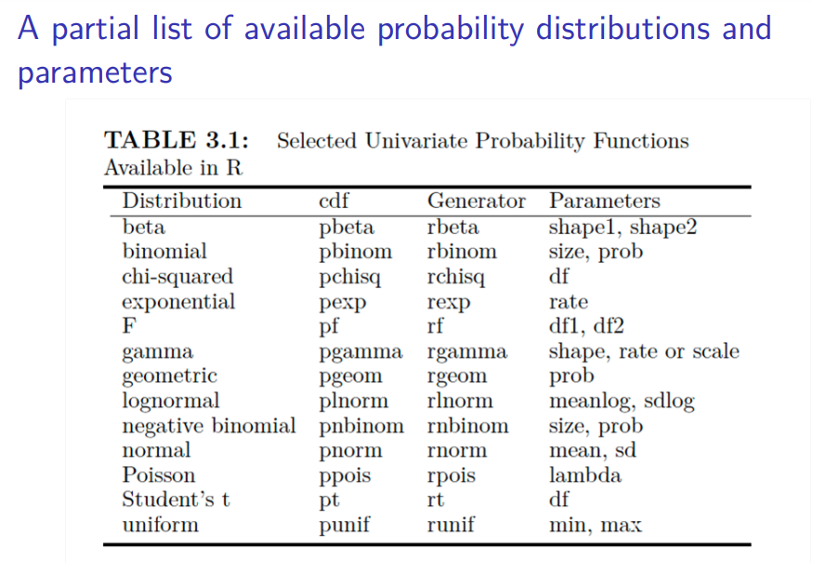

Slide 25
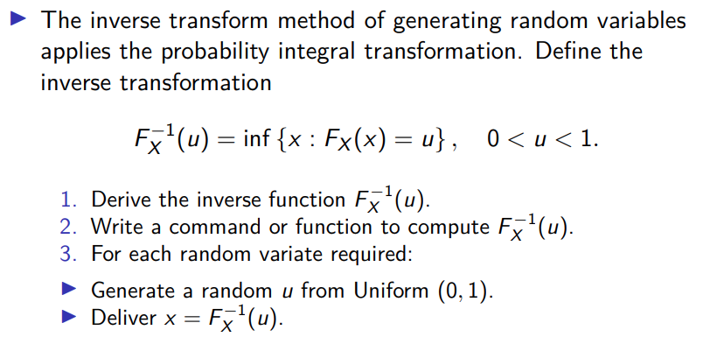
Inverse Transform Method – Continue Case

Slide 26
Inverse Transform Method – Continue Case
pdf → cdf → inverse function → f(unif(n))
n <- 1000;
u <- runif(n);
x <- uˆ(1/3);
hist(x, prob = TRUE) # density histogram of sample;
y <- seq(0,1,.01);
lines(y,3*yˆ2) #density curve f(x)

Slide 27
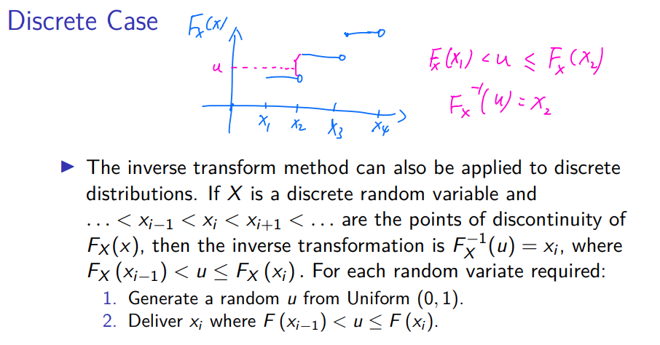
Inverse Transform Method – Discrete Case

Slide 28
Inverse Transform Method – Bernoulli
n <- 1000;
p <- 0.4;
u <- runif(n);
x <- as.integer(u > 0.6) # (u > 0.6) is a logical vector;
mean(x)
# Generate Bernoulli sample
n<- 10; p=0.6; rbinom(n, size <- 1, prob=p)
sample(c(0,1), size = n, replace = TRUE, prob = c(.6,.4))

Slide 29
Inverse Transform Method – Geometric
n <- 100;
p <- 0.25;
u <- runif(n);
k <- ceiling(log(1-u) / log(1-p)) - 1

Slide 30
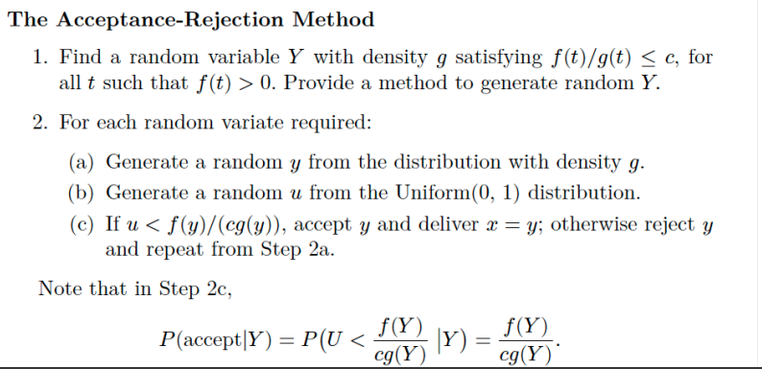
Acceptance-Rejection Method

Slide 31
Acceptance-Rejection Method -- Beta
n <- 1000; k <- 0 #counter for accepted; j <- 0 #iterations;
y <- numeric(n);
while (k < n) {
u <- runif(1);
j <- j +1 ;
x <- runif(1) # random variate from g
if (x * (1-x) > u) { # f(x)/c
#we accept x
k <- k + 1;
y[k] <- x;
}
}

Slide 32
#compare empirical and theoretical percentiles
p <- seq(.1, .8, .1)
Qhat <- quantile(y, p) #empirical quantiles
Q <- qbeta(p, 2, 2) #theoretical quantiles
se <- sqrt(p * (1-p) / (n * dbeta(Q, 2, 2)ˆ2))
round(rbind(Qhat, Q, se), 3) #n=1000

Slide 33
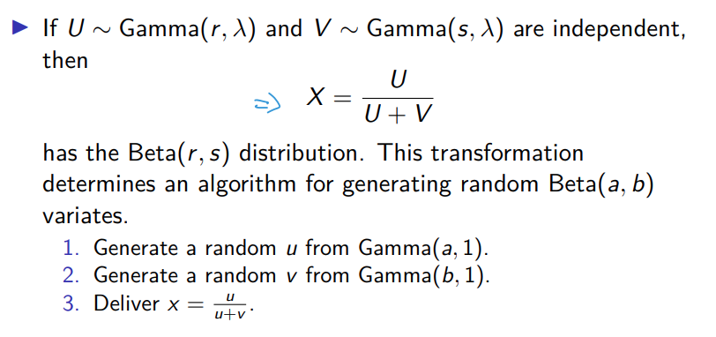
Transformation on Methods – Gamma & Beta

Slide 34
Transformation on Methods – Gamma & Beta
n <- 1000;
a <- 3;
b <- 2;
u <- rgamma(n, shape=a, rate=1);
v <- rgamma(n, shape=b, rate=1);
x <- u / (u + v);
q <- qbeta(ppoints(n), a, b);
qqplot(q, x, cex=0.25, xlab="Beta(3, 2)", ylab="Sample");
abline(0, 1);

Slide 35
Sums and Mixtures
Convolution Distributions
Chi-square(v): sum of v i.i.d. squared N(0, 1);
NegBin(r, p): sum of r i.i.d. Geom(p);
Gamma(r, lambda): sum of r i.i.d. Exp(lambda);

Slide 36
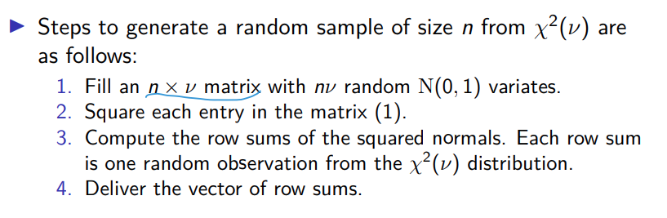
Sums and Mixtures – Chi-square

Slide 37
Sums and Mixtures – Sums of Chi-square
n <- 1000
nu <- 2
X <- matrix(rnorm(n*nu), n, nu)ˆ2 # matrix of sq. normal
# sum the squared normals across each row:
# method 1
y <- rowSums(X)
# method 2
y <- apply(X, MARGIN=1, FUN=sum) # a vector length n
mean(y) # mean is nu

Slide 38
Sums and Mixtures – Mixtures of Gamma
n <- 1000;
x1 <- rgamma(n, 2, 2);
x2 <- rgamma(n, 2, 4);
s <- x1 + x2 #the convolution;
u <- runif(n);
k <- as.integer(u > 0.5) #vector of 0s and 1s;
x <- k * x1 + (1-k) * x2 #the mixture;
par(mfcol=c(1,2)) #two graphs per page;
hist(s, prob=TRUE, xlim=c(0,5), ylim=c(0,1));
hist(x, prob=TRUE, xlim=c(0,5), ylim=c(0,1));
par(mfcol=c(1,1)) #restore display

Slide 39
Sums and Mixtures – Gamma
n <- 5000
p <- c(.1,.2,.2,.3,.2)
lambda <- c(1,1.5,2,2.5,3)
k <- sample(1:5, size=n, replace=TRUE, prob=p)
rate <- lambda[k]
x <- rgamma(n, shape=3, rate=rate)
plot(density(x), xlim=c(0,15), ylim=c(0,1), lwd=3, xlab="x", main="" , col="red")
for (i in 1:5) lines(density(rgamma(n, 3, lambda[i])))

Slide 40
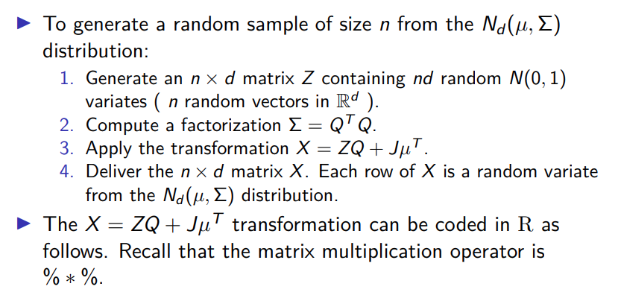
Multivariate Normal Sample Generation

Slide 41
Multivariate Normal Sample Generation
library(MASS);
mu <- c(0,0);
Sigma <- matrix(c(1,0.9,.9,1),2,2);
x <- mvrnorm(n = 100, mu = mean, Sigma = sd);
colMeans(x);
plot(x, xlab = "x", ylab = "y", pch = 20);

Slide 42
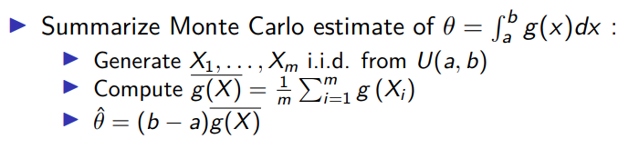
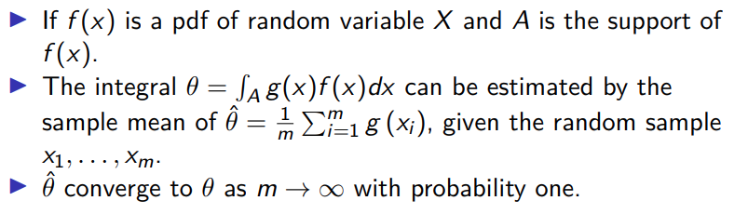
Monte Carlo Integration

Slide 43

Monte Carlo Integration
$E\left(g\left(x\right)\right)=\int_{−∞}^{∞}{g\left(x\right)f\left(x\right)dx= \int_{0}^{1}{g\left(x\right)dx≈\frac{1}{n}\sum_{i=1}^{n}{g\left(x_{i}\right)}}}$
m <- 10000
x <- runif(m, min = 2, max = 4)
theta.hat <- mean(exp(-x)) * (4-2)
print(theta.hat) # the estimated value

Slide 44
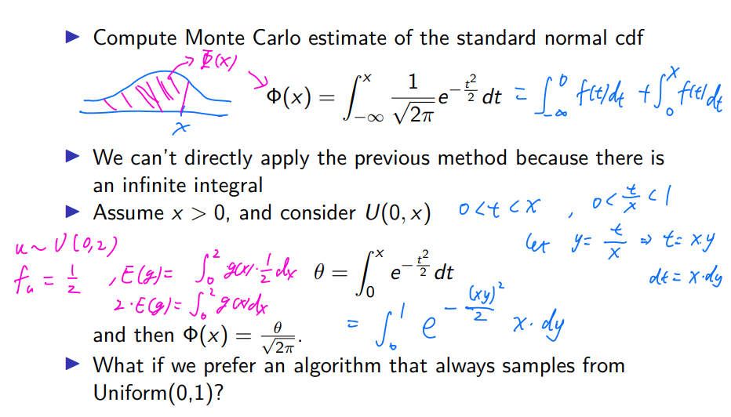
Monte Carlo Integration – Normal Distribution

Slide 45
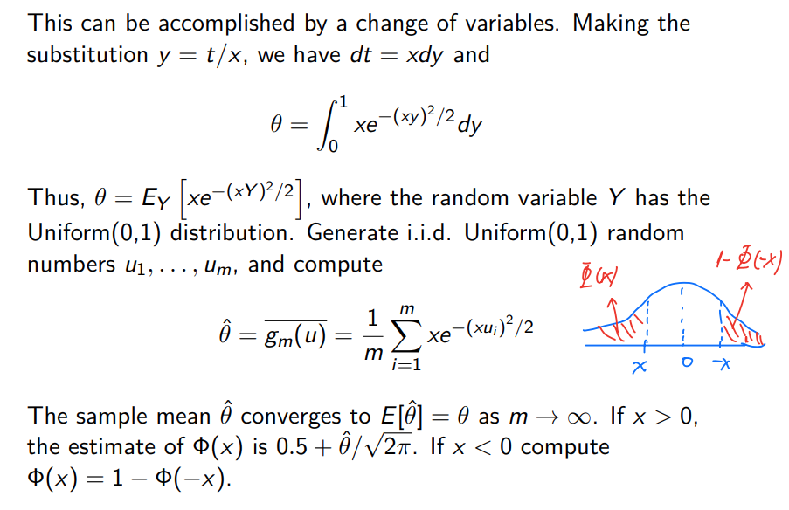
Monte Carlo Integration – Normal Distribution

Slide 46
Monte Carlo Integration – Normal Distribution1
x <- seq(.1, 2.5, length = 8);
m <- 10000
u <- runif(m)
cdf <- numeric(length(x))
for (i in 1:length(x)) {
g <- x[i] * exp(-(u * x[i])ˆ2 / 2)
cdf[i] <- mean(g) / sqrt(2 * pi) + 0.5
}
Phi <- pnorm(x)
print(round(rbind(x, cdf, Phi), 3))

Slide 47
Monte Carlo Integration – Normal Distribution2
x <- seq(.1, 2.5, length = 8);
m <- 10000
z <- rnorm(m)
dim(x) <- length(x)
p <- apply(x, MARGIN = 1,
FUN = function(x, z) {mean(z < x)}, z = z)
Phi <- pnorm(x)
print(round(rbind(x, p, Phi), 3))

Slide 48
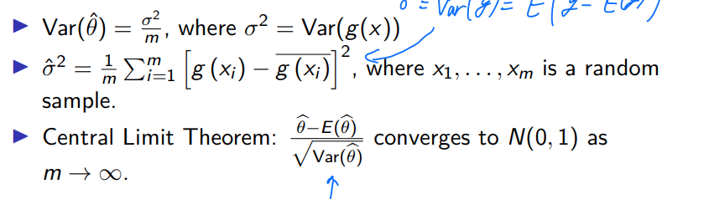
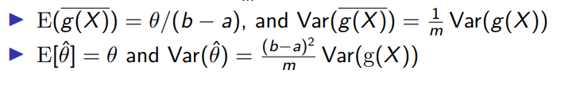
Monte Carlo Integration – Expection & Variance

Slide 49
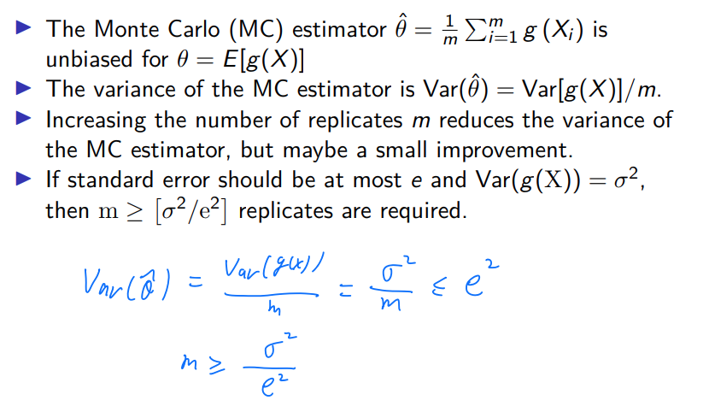
Monte Carlo Integration –Variance Reduction

Slide 50

Monte Carlo Integration – Confidence Interval
x <- 2
m <- 10000
z <- rnorm(m)
g <- (z < x) #the indicator function, hit or miss
v <- mean((g - mean(g))ˆ2) / m
cdf <- mean(g)
c(cdf, v)
c(cdf - 1.96 * sqrt(v), cdf + 1.96 * sqrt(v))

Slide 51

Monte Carlo Integration – Importance Sampling
m <- 10000
theta.hat <- se <- numeric(5)
g <- function(x) {
exp(-x)/(1+xˆ2) * (x > 0) * (x < 1)
}
x <- runif(m) #using f0 = 1.
fg <- g(x)
theta.hat[1] <- mean(fg)
se[1] <- sd(fg)
Inverse Function
CDF First!!!

Slide 52
Monte Carlo Integration – Importance Sampling
x <- rcauchy(m) #using f2
i <- c(which(x > 1), which(x < 0)) #indicator function.
x[i] <- 2 #to catch overflow errors in g(x)
fg <- g(x) / dcauchy(x)
theta.hat[3] <- mean(fg)
se[3] <- sd(fg)

Slide 53
Monte Carlo Integration – Importance Sampling
u <- runif(m) #f4, inverse transform method
x <- tan(pi * u / 4)
fg <- g(x) / (4 / ((1 + xˆ2) * pi))
theta.hat[5] <- mean(fg)
se[5] <- sd(fg)
round(rbind(theta.hat, se),3)

Slide 54
Empirical & Theoretical Probabilities
Construct a relative frequency table and compare the empirical with the theoretical probabilities
n <- 1000; u <- runif(n) # generate 1000 sample from random uniform
x <- numeric(1000)
for(i in 1:1000){
if(u[i] <= 0.1){ x[i] <- 0
} else if(u[i]>0.1 & u[i] <=0.3){
x[i] <- 1
} else if(u[i]>0.3 & u[i] <=0.5){
x[i] <- 2
} else if(u[i]>0.5 & u[i] <=0.7){
x[i] <- 3
} else if(u[i]>0.7 & u[i] <=1){
x[i] <- 4}
}
table(x)/n
Notes:
Construct a relative frequency table and compare the empirical with the theoretical probabilities

Slide 55

MC Estimation – Basic Estimation
m <- 1000
g <- numeric(m)
for (i in 1:m) {
x <- rnorm(2)
g[i] <- abs(x[1] - x[2])
}
est <- mean(g)
est

Slide 56
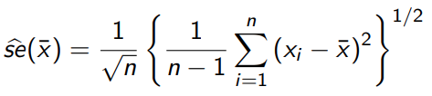
MC Estimation – Standard Error
# MC value
sqrt(sum((g - mean(g))ˆ2)) / m
# standard error of theta
sqrt((2-4/pi)/1000)

Slide 57
MC Estimation – Confidence Interval for Variance
The calculation of the 95% upper confidence limit (UCL) for a random sample size n = 20 from a Normal (0, 4).
n <- 20
alpha <- .05
x <- rnorm(n, mean=0, sd=2)
UCL <- (n-1) * var(x) / qchisq(alpha, df=n-1)

Slide 58
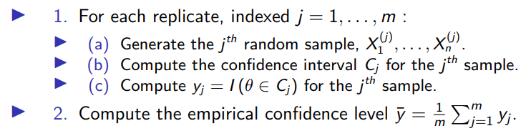
MC Estimation – Confidence Level

Slide 59

MC Estimation – Confidence Level of Var1
n <- 20; alpha <- .05
UCL <- replicate(1000, expr = {
x <- rnorm(n, mean = 0, sd = 2)
(n-1) * var(x) / qchisq(alpha, df = n-1)
})
#count the number of intervals that contain sigmaˆ2=4
#or compute the mean to get the confidence level
c(sum(UCL > 4), mean(UCL > 4) )
Calculate variance:

Slide 60
MC Estimation – Confidence Level of Var2
calcCI <- function(n, alpha) {
y <- rnorm(n, mean = 0, sd = 2)
return((n-1) * var(y) / qchisq(alpha, df = n-1))
}
UCL <- replicate(1000, expr=calcCI(n = 20, alpha=.05))
mean(UCL > 4)
Notes:
y <- numeric(m)
for(i in 1:1000){
x <- rnorm(50,30,10)
zq <- qnorm(0.975) # quantile
c.i <- c(mean(x)-zq*10/sqrt(n), mean(x)+zq*10/sqrt(n) ) # Confidence interval y[i] <- (mu> c.i[1]) & (mu< c.i[2]) # record whether \mu is in the interval
} mean(y)

Slide 61
MC Estimation – Confidence Level of Mean
y <- numeric(m)
for(i in 1:1000) {
x <- rnorm(50,30,10)
zq <- qnorm(0.975) # quantile
# Confidence interval
c.i <- c(mean(x)-zq*10/sqrt(n), mean(x)+zq*10/sqrt(n) )
# record whether \mu is in the interval
y[i] <- (mu> c.i[1]) & (mu< c.i[2])
}
mean(y)

Slide 62
MC Estimation – Empirical Confidence Level
Suppose that the sampled population is χ^2 (2), which has variance 4 . We repeat the simulation, replacing the N(0, 4) samples with χ^2 (2) samples.
set.seed(12); n <- 20; alpha <- .05
UCL <- replicate(1000, expr = {
x <- rchisq(n, df = 2)
(n-1) * var(x) / qchisq(alpha, df = n-1)
})
c(sum(UCL > 4), mean(UCL > 4) )

Slide 63
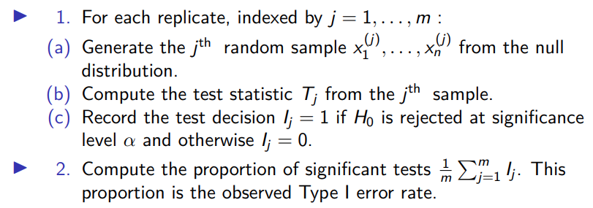
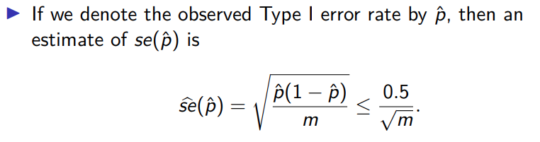
MC Estimation – Type I Error Rate

Slide 64
MC Estimation – Type I Error Rate
n <- 20; alpha <- .05; mu0 <- 500; sigma <- 100
m <- 10000 #number of replicates
p <- numeric(m) #storage for p-values
for (j in 1:m) {
x <- rnorm(n, mu0, sigma)
ttest <- t.test(x, alternative = "greater", mu = mu0) # Here is H1.
p[j] <- ttest$p.value
}
p.hat <- mean(p < alpha) # empirical error rate
se.hat <- sqrt(p.hat * (1 - p.hat) / m) # theoretical rate
print(c(p.hat, se.hat))

Slide 65
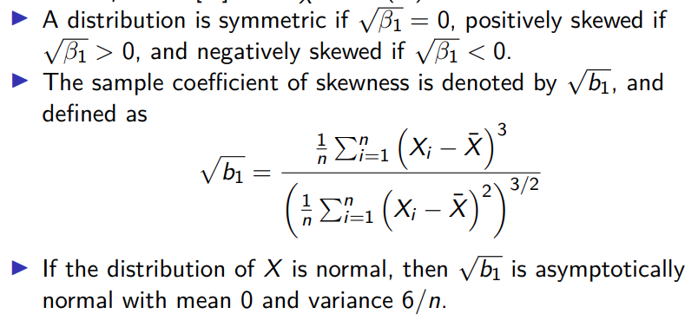
MC Estimation – Skewness Test of Normality

Slide 66
MC Estimation – Skewness Test of Normality
n <- 50
cv <- qnorm(.975, 0, sqrt(6*(n-2)/((n+1)*(n+3)))) #crit. values for n.
# For sample size n[i], H0 is rejected if | √ b1| > cv[i]
# compute the sample skewness statistic
sk <- function(x) {
xbar <- mean(x)
m3 <- mean((x - xbar)ˆ3)
m2 <- mean((x - xbar)ˆ2)
return( m3 / m2ˆ1.5 )
}

Slide 67
m <- 1000
for (j in 1:m) {
# generate data x
for(i in 1:n){
# mix normal distribution.
k <- sample(1:2,1,prob = c(0.6,0.4))
if(k ==1) x[i] = rnorm(1,0,1)
if(k ==2) x[i] = rnorm(1,1,3)
}
# test decision is 1 (reject) or 0
sktests[j] <- as.integer(abs(sk(x)) >= cv)
}
p.reject <- mean(sktests) # proportion rejected
print(p.reject)

Slide 68
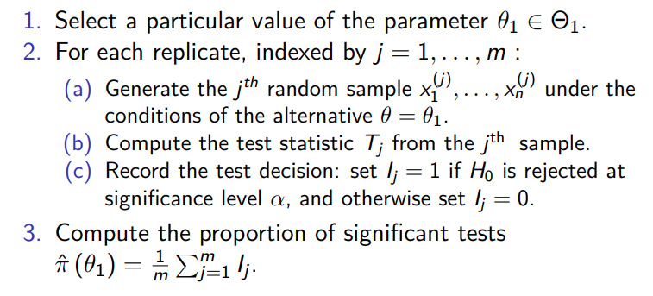
MC Estimation – Power of a Test

Slide 69
MC Estimation – Power of a Test
Use simulation to estimate power and plot an empirical power curve for the t-test in Example (Type I error rate).
We desire ppb. of reject H0 accept H1 --> type I error
power larger better.
n <- 20; m <- 1000
mu0 <- 500; sigma <- 100
mu <- c(seq(450, 650, 10)) #alternatives
M <- length(mu)
power <- numeric(M)

Slide 70
for (i in 1:M) {
mu1 <- mu[i]
pvalues <- replicate(m, expr = {
#simulate under alternative mu1
x <- rnorm(n, mean = mu1, sd = sigma)
ttest <- t.test(x, alternative = "greater", mu = mu0)
ttest$p.value
})
power[i] <- mean(pvalues <= .05)
}
se <- sqrt(power * (1-power) / m)

Slide 71
#install.packages("ggplot2")
library(ggplot2)
df <- data.frame(mean=mu, power=power, upper=power+2*se, lower=power-2*se)
ggplot(df, aes(x=mean, y=power)) +
geom_line() +
geom_vline(xintercept=500, lty=2) +
geom_hline(yintercept=c(0,.05), lty=1:2) +
geom_errorbar(aes(ymin=lower,ymax=upper),width=0.2,lwd=1.5)

Slide 72
Bootstrap – Standard Error
#set up the bootstrap
B <- 200 #number of replicates
n <- nrow(law) #sample size
R <- numeric(B) #storage for replicate
for (b in 1:B) {
#randomly select the indices
i <- sample(1:n, size = n, replace = TRUE)
LSAT <- law$LSAT[i] #i is a vector of indices
GPA <- law$GPA[i]
R[b] <- cor(LSAT, GPA)
}
print(se.R <- sd(R)) ; hist(R, prob = TRUE)

Slide 73
Bootstrap – Bias
#sample estimate for n=15
theta.hat <- cor(law$LSAT, law$GPA)
B <- 2000 #larger for estimating bias
n <- nrow(law)
theta.b <- numeric(B)
for (b in 1:B) {
i <- sample(1:n, size = n, replace = TRUE)
LSAT <- law$LSAT[i]
GPA <- law$GPA[i]
theta.b[b] <- cor(LSAT, GPA)
}
bias <- mean(theta.b - theta.hat)
bias

Slide 74
Bootstrap – Bias & Standard Error
#install.packages("bootstrap")
library(bootstrap)
n <- nrow(law)
# use bootstrap method to estimate bias.
#sample estimate for n=15
theta.hat <- cor(law$LSAT, law$GPA)
#bootstrap estimate of bias
B <- 2000 #larger for estimating bias
theta.b <- numeric(B)
Notes:
for (b in 1:B) {
i <- sample(1:n, size = n, replace = TRUE)
LSAT <- law$LSAT[i]
GPA <- law$GPA[i]
theta.b[b] <- cor(LSAT, GPA)
}
boot_bias <- mean(theta.b - theta.hat)
# use bootstrap method to estimate standard error.
#set up the bootstrap
B <- 200 #number of replicates
R <- numeric(B) #storage for replicates
#bootstrap estimate of standard error of R
for (b in 1:B) {
#randomly select the indices
i <- sample(1:n, size = n, replace = TRUE)
LSAT <- law$LSAT[i] #i is a vector of indices
GPA <- law$GPA[i]
R[b] <- cor(LSAT, GPA)
}
boot_sd <- sd(R)
cat("Bootstrap estimate of bias:", boot_bias, "\n")
cat("Bootstrap estimate of standard error:", boot_sd, "\n")

Slide 75
for (b in 1:B) {
i <- sample(1:n, size = n, replace = TRUE)
LSAT <- law$LSAT[i]
GPA <- law$GPA[i]
theta.b[b] <- cor(LSAT, GPA)
}
boot_bias <- mean(theta.b - theta.hat)
# use bootstrap method to estimate standard error.
#set up the bootstrap
B <- 200 #number of replicates
R <- numeric(B) #storage for replicates
#bootstrap estimate of standard error of R
for (b in 1:B) {
#randomly select the indices
i <- sample(1:n, size = n, replace = TRUE)
LSAT <- law$LSAT[i] #i is a vector of indices
GPA <- law$GPA[i]
R[b] <- cor(LSAT, GPA)
}
boot_sd <- sd(R)
cat("Bootstrap estimate of bias:", boot_bias, "\n")
cat("Bootstrap estimate of standard error:", boot_sd, "\n")
Notes:
for (b in 1:B) {
i <- sample(1:n, size = n, replace = TRUE)
LSAT <- law$LSAT[i]
GPA <- law$GPA[i]
theta.b[b] <- cor(LSAT, GPA)
}
boot_bias <- mean(theta.b - theta.hat)
# use bootstrap method to estimate standard error.
#set up the bootstrap
B <- 200 #number of replicates
R <- numeric(B) #storage for replicates
#bootstrap estimate of standard error of R
for (b in 1:B) {
#randomly select the indices
i <- sample(1:n, size = n, replace = TRUE)
LSAT <- law$LSAT[i] #i is a vector of indices
GPA <- law$GPA[i]
R[b] <- cor(LSAT, GPA)
}
boot_sd <- sd(R)
cat("Bootstrap estimate of bias:", boot_bias, "\n")
cat("Bootstrap estimate of standard error:", boot_sd, "\n")

Slide 76
Bootstrap Estimate – boot Function
boot(data, statistic, R) R is the number of bootstrap replicates.
f <- function(x, i) {
#want correlation of columns 1 and 2
cor(x[i,1], x[i,2])
}
library(boot) #for boot function
obj <- boot(data = law, statistic = f, R = 2000)
sd(obj$t) # $t will call the replicates of the statistic
mean(obj$t - obj$t0) # $t0 will call the statistic
obj

Slide 77
Bootstrap Estimate of Bias of a Ratio Estimate
n <- nrow(patch) #in bootstrap package
B <- 2000
theta.b <- numeric(B)
theta.hat <- mean(patch$y) / mean(patch$z)
# bootstrap method
for (b in 1:B) {
i <- sample(1:n, size = n, replace = TRUE)
y <- patch$y[i]
z <- patch$z[i]
theta.b[b] <- mean(y) / mean(z)
}

Slide 78
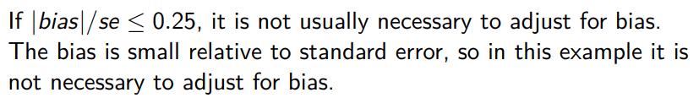
bias <- mean(theta.b) - theta.hat
se <- sd(theta.b)
print(list(est=theta.hat, bias = bias, se = se, cv = bias/se))
f <- function(x, i){
mean(x[i,1]) / mean(x[i,2])
}
r.patch = patch[,c(6,5)]
obj <- boot(data = r.patch, statistic = f, R = 2000)
obj

Slide 79

Bootstrap – Confidence Interval for Correlation Statistic
library(boot)
data(law, package = "bootstrap")
boot.obj <- boot(law, R = 2000, statistic = function(x, i){
cor(x[i,1], x[i,2])
})
print(boot.ci(boot.obj, type=c("basic","norm","perc")))

Slide 80
Bootstrap – t Confidence Interval
boot.t.ci <- function(x, B = 500, R = 100, level = .95, statistic) {
#compute the bootstrap t CI
x <- as.matrix(x); n <- nrow(x)
stat <- numeric(B); se <- numeric(B)
for (b in 1:B) {
j <- sample(1:n, size = n, replace= TRUE)
y <- x[j, ]
stat[b] <- statistic(y)
se[b] <- boot.se(y, R = R, f=statistic)
}

Slide 81
stat0 <- statistic(x);
se0 <- sd(stat)
t.stats <- (stat - stat0)/se
alpha <- 1 – level
Qt <- quantile(t.stats, c(alpha/2, 1-alpha/2), type = 1)
names(Qt) <- rev(names(Qt))
CI <- rev(stat0 - Qt * se0)
}
boot.se <- function(x, R, f) {
#local function to compute the bootstrap #estimate of standard error for statistic f(x) x <- as.matrix(x); m <- nrow(x)
th <- replicate(R, expr = {
i <- sample(1:m, size = m, replace = TRUE) f(x[i, ])
})
return(sd(th))
}

Slide 82
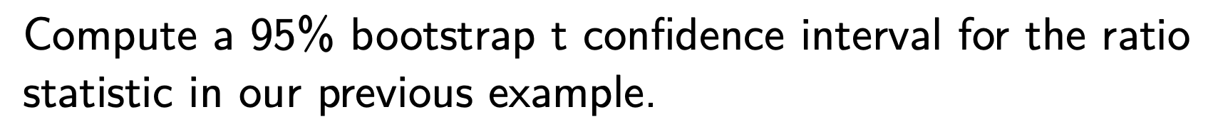
dat <- cbind(patch$y, patch$z)
stat <- function(dat){
mean(dat[, 1]) / mean(dat[, 2]) }
ci <- boot.t.ci(dat, statistic = stat, B=2000, R=200) print(ci)

Slide 83
Jackknife Estimates – Correlation and Bias
# Calculate the jackknife estimates.
theta.jack <- numeric(n)
theta.hat <- cor(law$LSAT,law$GPA)
for (i in 1:n)
theta.jack[i] <- cor(law$LSAT[-i],law$GPA[-i])
# Calculate the jackknife estimate of the bias.
jack_bias <- (n - 1) * (mean(theta.jack) - theta.hat)

Slide 84
Jackknife Estimates – Correlation and Bias
# Calculate the jackknife estimate of the standard error。
jack_se <- sqrt((n - 1) * mean((theta.jack - mean(theta.jack))^2))
# Print the results
cat("Jackknife estimate of bias:", jack_bias, "\n")
cat("Jackknife estimate of standard error:", jack_se, "\n")

Slide 85
Jackknife After Bootstrap – Standard Error
# initialize
data(patch, package = "bootstrap")
n <- nrow(patch)
y <- patch$y
z <- patch$z
B <- 2000
theta.b <- numeric(B)
# set up storage for the sampled indices
indices <- matrix(0, nrow = B, ncol = n)

Slide 86
# jackknife-after-bootstrap step 1: run the bootstrap
for (b in 1:B) {
i <- sample(1:n, size = n, replace = TRUE)
y <- patch$y[i]
z <- patch$z[i]
theta.b[b] <- mean(y) / mean(z)
#save the indices for the jackknife
indices[b, ] <- i
}
#jackknife-after-bootstrap to est. se(se)
se.jack <- numeric(n)
for (i in 1:n) {
#in i-th replicate omit all samples with x[i]
keep <- (1:B)[apply(indices, MARGIN = 1,
FUN = function(k) {!any(k == i)}
se.jack[i] <- sd(theta.b[keep])
}
print(sd(theta.b))
print(sqrt((n-1) * mean((se.jack - mean(se.jack))ˆ2)))

Slide 87
Histogram – Sturges’ Rule
n <- 25
x <- rnorm(n)
# calc breaks according to Sturges’ Rule
nclass <- ceiling(1 + log2(n))
cwidth <- diff(range(x) / nclass)
breaks <- min(x) + cwidth * 0:nclass
h.default <- hist(x, freq = FALSE, xlab = "default",
main = "hist: default")
z <- qnorm(ppoints(1000))
lines(z, dnorm(z))
h.sturges <- hist(x, breaks = breaks, freq = FALSE,
lines(z, dnorm(z))
print(round(h.sturges$breaks, 1))
print(h.sturges$counts)

Slide 88
x0 <- .1
b <- which.min(h.default$breaks <= x0) - 1
print(c(b, h.default$density[b]))
OR
b <- which.min(h.sturges$breaks <= x0) - 1
print(c(b, h.sturges$density[b]))

Slide 89
Histogram – Scotts’ Rule
library(MASS) #for geyser and truehist
waiting <- geyser$waiting
n <- length(waiting)
# rounding the constant in Scott’s rule
# and using sample standard deviation to estimate sigm h <- 3.5 * sd(waiting) * nˆ(-1/3)
# number of classes is determined by the range and h
m <- min(waiting)
M <- max(waiting)
nclass <- ceiling((M - m) / h)
breaks <- m + h * 0:nclass

Slide 90
par(mfrow=c(1,3))
h.scott<-hist(waiting, breaks=breaks, freq=FALSE,main=
truehist(waiting,nbins="Scott", x0=0,prob=TRUE,col=0)
hist(waiting, breaks = "scott", prob=TRUE,density=5)

Slide 91
Frequency Polygon Density Estimate
waiting <- geyser$waiting #in MASS
n <- length(waiting)
# freq poly bin width using normal ref rule h <- 2.15 * sd(waiting) * nˆ(-1/5)
# calculate the sequence of breaks and histogram
br <- pretty(waiting, diff(range(waiting)) / h)
brplus <- c(min(br)-h, max(br)+h)
histg <- hist(waiting, breaks = br, freq = FALSE,
main = "", xlim = brplus)

Slide 92
vx <- histg$mids #density est at vertices of polygon vy <- histg$density
delta <- diff(vx)[1] # h after pretty is applied
k <- length(vx)
vx <- c(vx[1] - delta, vx, vx[k] + delta) vy <- c(0, vy, 0)
# add the polygon to the histogram polygon(vx, vy)
# check estimates by numerical integration
fpoly <- approxfun(vx, vy)
print(integrate(fpoly, lower=min(vx), upper=max(vx)))
library(ggplot2)
ggplot(geyser, aes(waiting)) + geom_freqpoly(binwidth=h)

Slide 93
Average Shifted Histogram (ASH)
library(MASS)
waiting <- geyser$waiting
n <- length(waiting)
m <- 20
a <- min(waiting) - .5
b <- max(waiting) + .5
h <- 7.27037
delta <- h / m
#get the bin counts on the delta-width mesh.
br <- seq(a - delta*m, b + 2*delta*m, delta) histg <- hist(waiting, breaks = br, plot = FALSE) nk <- histg$counts
K <- abs((1-m):(m-1))

Slide 94
fhat <- function(x) {
# locate the leftmost interval containing x
i <- max(which(x > br))
k <- (i - m + 1):(i + m - 1)
# get the 2m-1 bin counts centered at x
vk <- nk[k]
sum((1 - K / m) * vk) / (n * h) #f.hat
}
# density can be computed at any points in range of data
z <- as.matrix(seq(a, b + h, .1))
f.ash <- apply(z, 1, fhat) #density estimates at midptta s
# plot ASH density estimate over histogram
br2 <- seq(a, b + h, h)
hist(waiting, breaks = br2, freq = FALSE,
main = "", ylim = c(0, max(f.ash)))
lines(z, f.ash, xlab = "waiting")

Slide 95
Kernel Density Estimation -- Gaussian
library(MASS)
waiting <- geyser$waiting
n <- length(waiting)
# If the true density is not unimodal: h1.
h1 <- 1.06 * sd(waiting) * nˆ(-1/5)
# better estimate.
h2 <- .9 * min(c(IQR(waiting)/1.34,
sd(waiting))) * nˆ(-1/5)
par(mfrow = c(2, 2))
plot(density(precip)) #default Gaussian (h0)
plot(density(precip, bw = h1)) #Gaussian, bandwidth h1
plot(density(precip, bw = h2)) #Gaussian, bandwidth h2
plot(density(precip, kernel = "cosine"))

Slide 96
# estimate density for new points.
d <- density(precip)
xnew <- seq(0, 70, 10)
approx(d$x, d$y, xout = xnew) # see ?approx.
OR
fhat <- approxfun(d$x, d$y)
fhat(xnew)

Slide 97
Kernel Density Estimation -- Exponential
x <- rexp(1000, 1)
xx <- c(x, -x)
g <- density(xx, bw = bw.nrd0(x))
a <- seq(0, 6, .01)
ghat <- approx(g$x, g$y, xout = a)
fhat <- 2 * ghat$y # density estimate along a
bw <- paste("Bandwidth = ", round(g$bw, 5))
plot(a, fhat, type="l", xlim=c(-1, 6), ylim=c(0, 1),
main = "", xlab = bw, ylab = "Density")
abline(v = 0)
# add the true density to compare
y <- seq(.001, 6, .01)
lines(y, dexp(y, 1), lty = 2)

Slide 98
Bisection Method
f <- function(y, a, n) {
aˆ2 + yˆ2 + 2*a*y/(n-1) - (n-2)
}
a <- 0.5; n <- 20
b0 <- 0; b1 <- 5*n
#solve using bisection
it <- 0
eps <- .Machine$double.epsˆ0.25
r <- seq(b0, b1, length=3)
y <- c(f(r[1], a, n), f(r[2], a, n), f(r[3], a, n)) if (y[1] * y[3] > 0)
stop("f does not have opposite sign at endpoints")
while(it < 1000 & abs(y[2]) > eps) {
it <- it + 1
if (y[1]*y[2] < 0) { r[3] <- r[2]; y[3] <- y[2]}
else { r[1] <- r[2]; y[1] <- y[2] } r[2] <- (r[1] + r[3]) / 2
y[2] <- f(r[2], a=a, n=n) print(c(r[1], y[1], y[3]-y[2]))
}

Slide 99
Brent’s Method
a <- 0.5; n <- 20
out <- uniroot(
function(y){ aˆ2 + yˆ2 + 2*a*y/(n-1) - (n-2) },
lower = 0, upper = n*5 )
unlist(out)
out <- uniroot(
function(y){ aˆ2 + yˆ2 + 2*a*y/(n-1) - (n-2) }, lower = -n*5, upper = 0 )
out$root

Slide 100
Numerical Integration
f <- function(y, n, r, rho) { (cosh(y) - rho * r)ˆ(1 – n) }
integrate(f, lower=0, upper=Inf,
rel.tol=.Machine$double.epsˆ0.25, n=10, r=0.5, rho=0.2)
ro <- seq(-.99, .99, .01)
v <- rep(0, length(ro))
for(i in 1:length(ro)) {
v[i] <- integrate(f, lower=0, upper=Inf, rel.tol=.Machine$double.epsˆ0.25, n=10, r=0.5, rho=ro[i])$value }
plot(ro, v, type="l", xlab=expression(rho),
ylab="Integral Value (n=10, r=0.5)")

Slide 101
MLE with mle
#the observed sample
y <- c(0.04304550, 0.50263474)
mlogL <- function(theta=1){
#minus log-likelihood of exp. density, rate 1/theta return(-(length(y) * log(theta) - theta * sum(y))) }
library(stats4)
fit <- mle(mlogL)
summary(fit)
mle(mlogL, start=list(theta=mean(y)))

Slide 102
Optimization
optimize(f, lower = 4, upper = 8, maximum = TRUE)
LL <- function(theta, sx, slogx, n) {
r <- theta[1]
lambda <- theta[2]
loglik <- n * r * log(lambda) + (r - 1) * slogx -
lambda * sx - n * log(gamma(r))
- loglik
}

